Slide 1
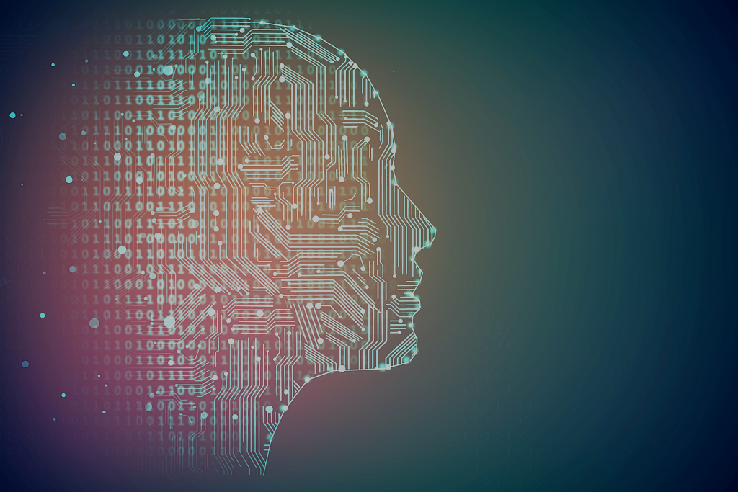
Deep Learning and Big Data Intelligence
1.Course Overview
Jing Wen
Spring 2023
CN:CST31209
蓝墨云班号：8317413
QQ群号：283630846

Slide 2
1.Course Overview
AI
ML
DL
NN

Slide 3
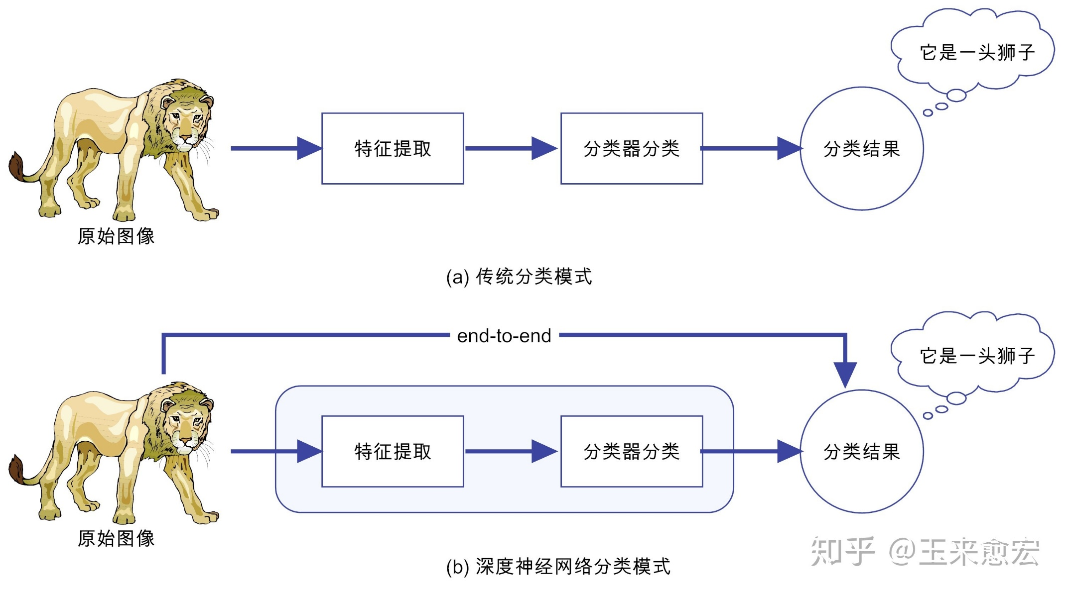
1.Course Overview
传统的ML VS DL

Slide 4
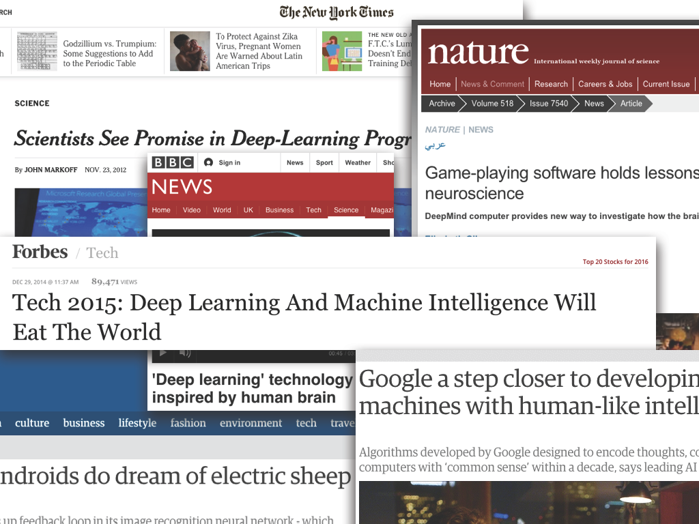
Deep Learning: Hype or Hope?

Slide 5
Deep Learning: Hype or Hope?
Hype: (n) “extravagant or intensive publicity or promotion”
Hope: (n) “expectation of fulfillment or success”

Slide 6
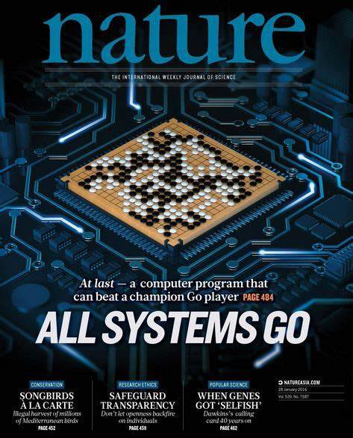
Notes:
计算+强化学习

Slide 7
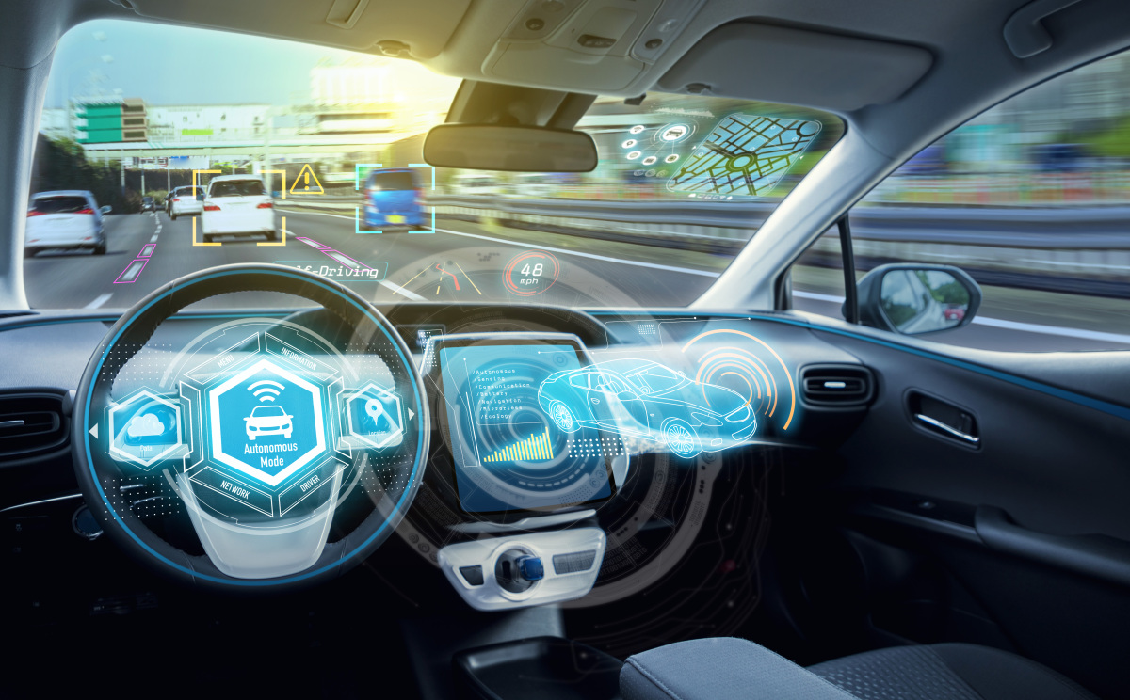
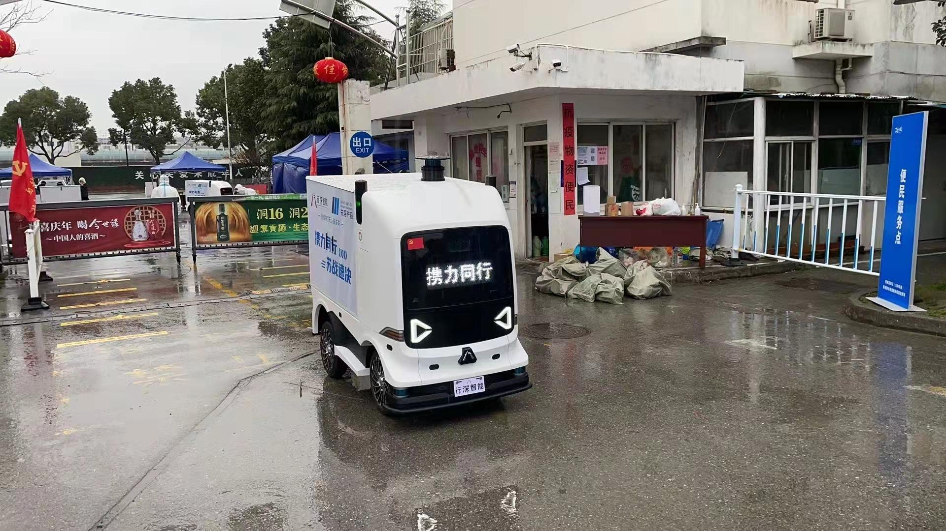

Slide 8
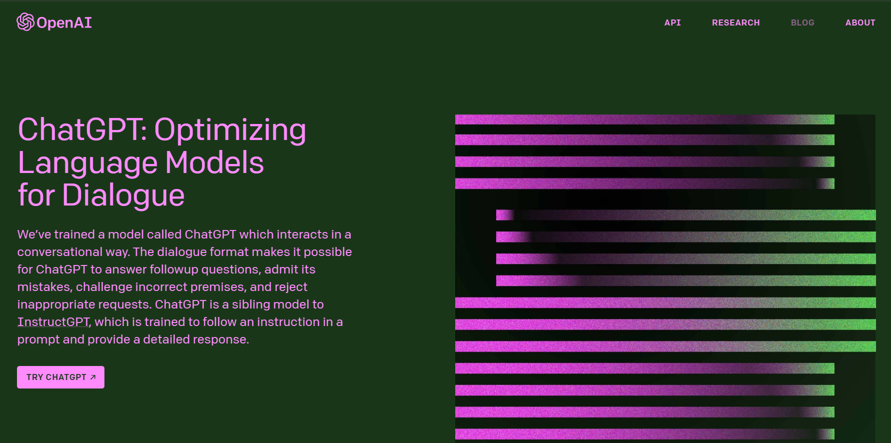

Slide 9
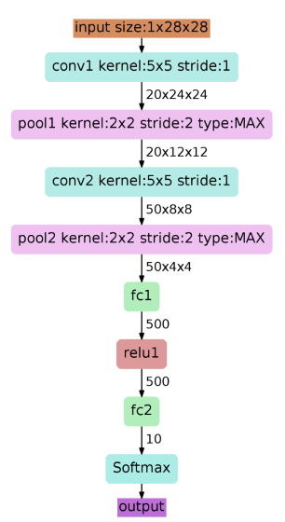
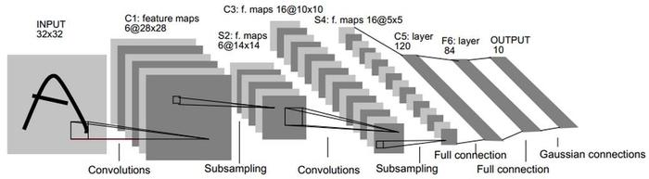
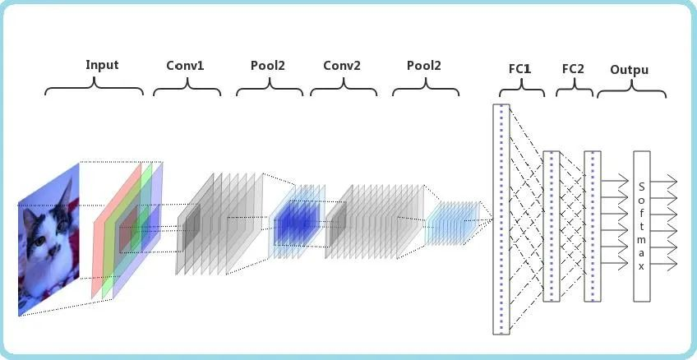
Milestones1: LeNet5
Source：LeCun et al. Gradient-Based Learning Applied to Document Recognition，1998
Notes:
LeNet是卷积神经网络的祖师爷LeCun在1998年提出，用于解决手写数字识别的视觉任务。自那时起，CNN的最基本的架构就定下来了：卷积层、池化层、全连接层。如今各大深度学习框架中所使用的LeNet都是简化改进过的LeNet-5（-5表示具有5个层），和原始的LeNet有些许不同，比如把激活函数改为了现在很常用的ReLu。

Slide 10
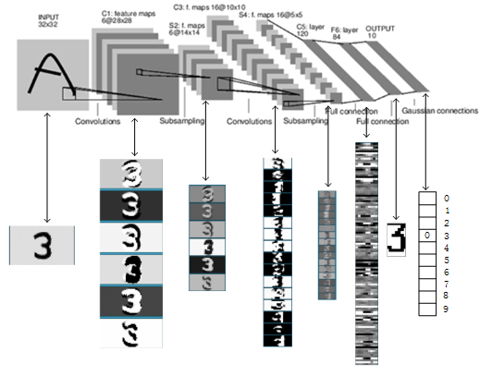
共约有60,840个训练参数，340,908个连接

Slide 11
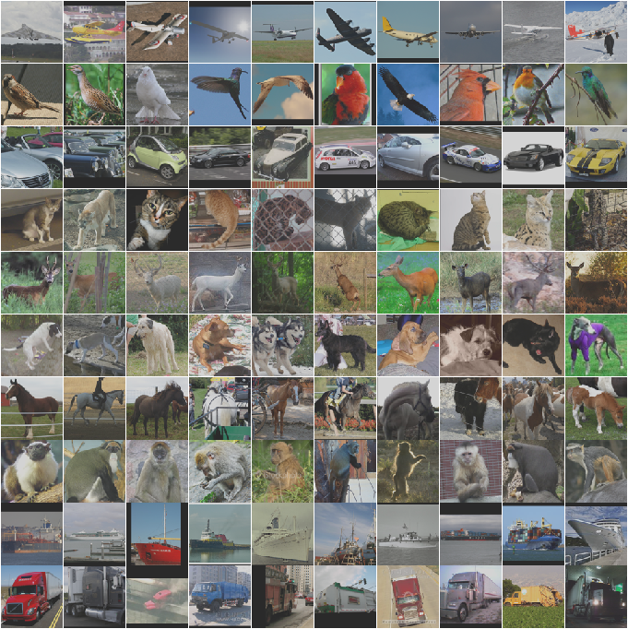
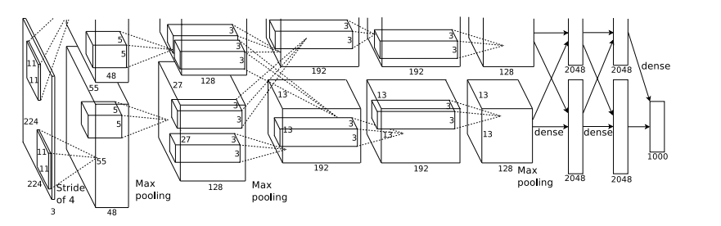
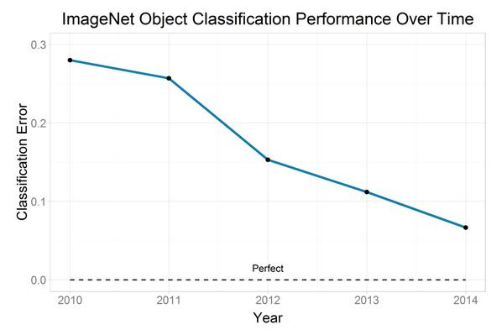
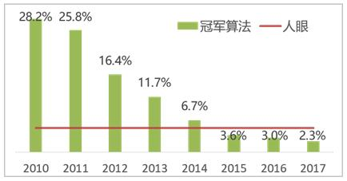
Milestones2: Image Classification
Convolutional NNs: AlexNet (2012): trained on 200 GB of ImageNet Data
多伦多大学，ImageNet LSVRC-2010
Large error rate reduction due to Deep CNN
Human performance 5.1% error
AlexNet(8)
OverFeat(8)
ZFNET
VGG(19)/
GoogleNet(22)
《ImageNet Classification with Deep Convolutional Neural Networks》,2012
ResNet(152)
SENet(152)
ImageNet Large-Scale Visual Recognition Challenge
Notes:
闪光点：
更深的网络 数据增广 ReLU dropout LRN局部响应归一层
两片GPU计算
前面5层是卷积层，后面三层是全连接层，最终softmax输出是1000类

Slide 12
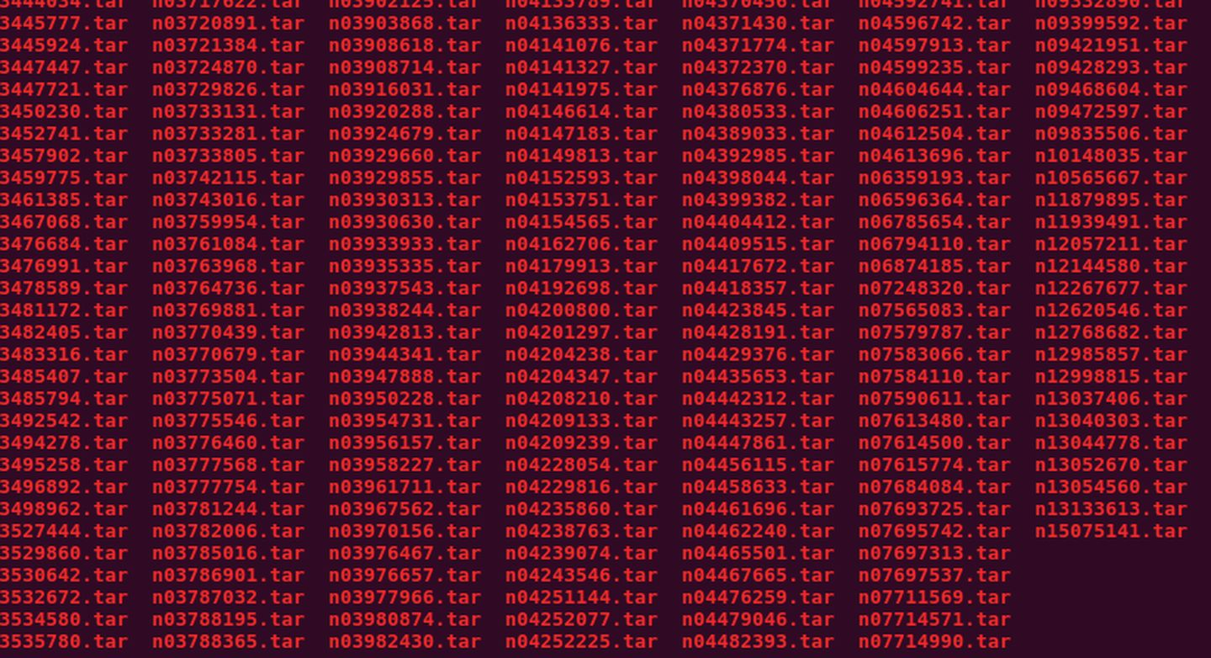

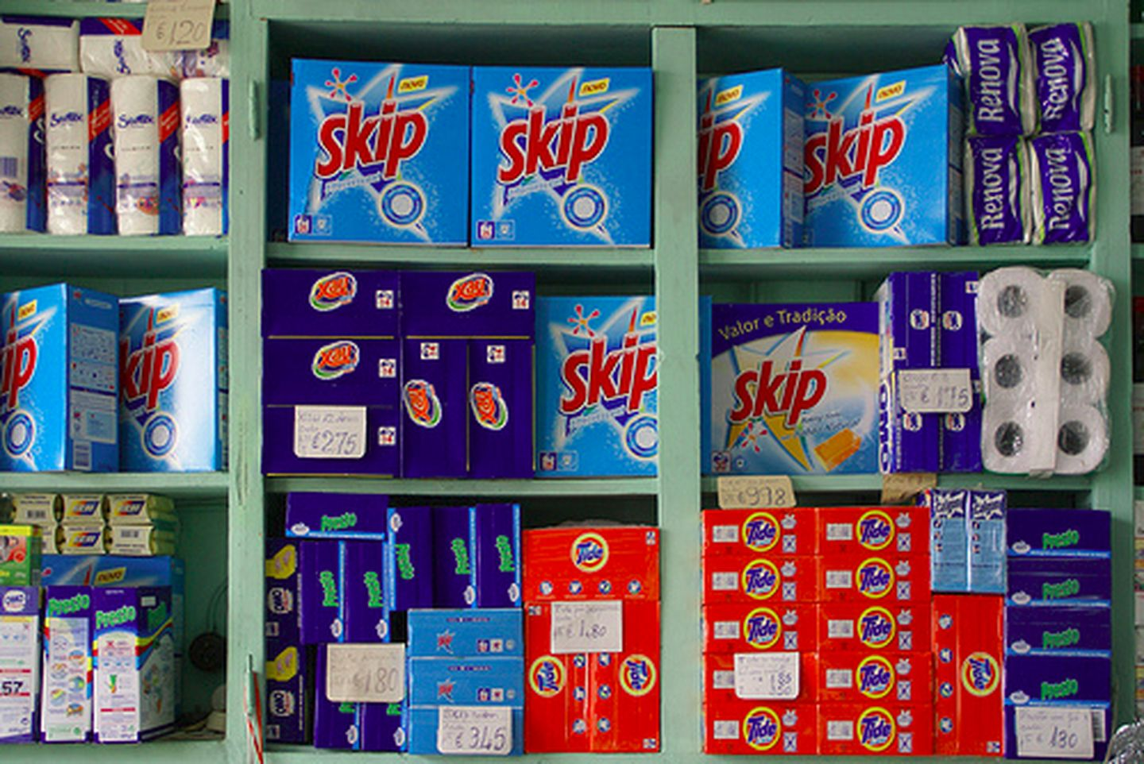
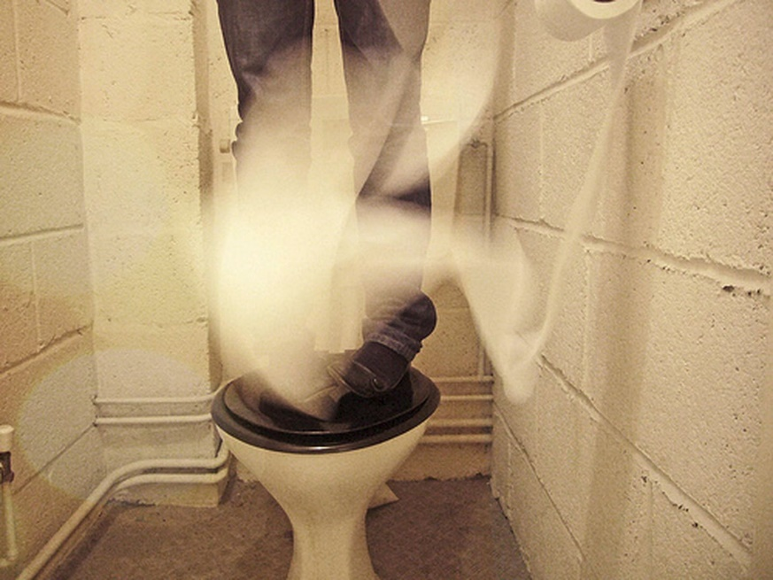
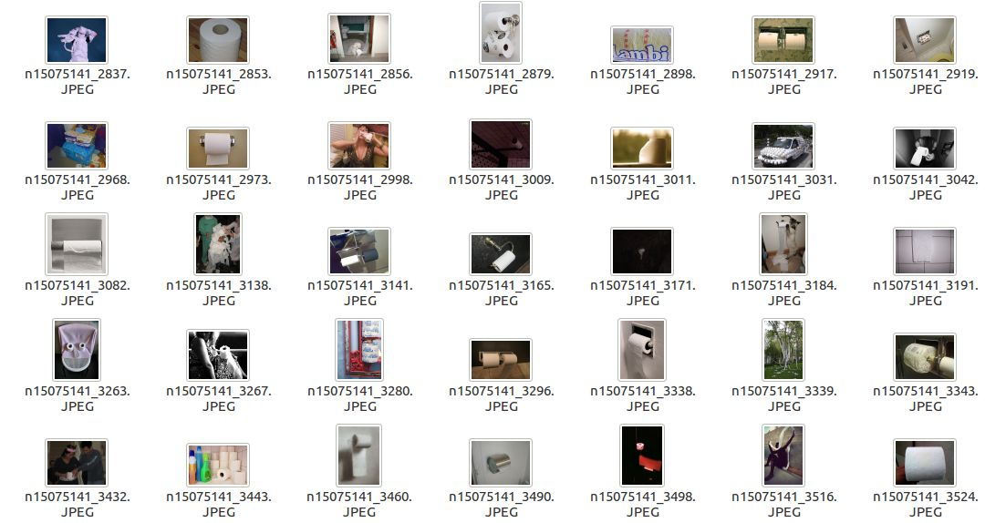
ImageNet
Notes:
超过15 million的图像数据集，大约有22,000类
ILSVRC使用的数据集是ImageNet数据集的一个子集，总共有1000类，每类大约有1000张图像

Slide 13
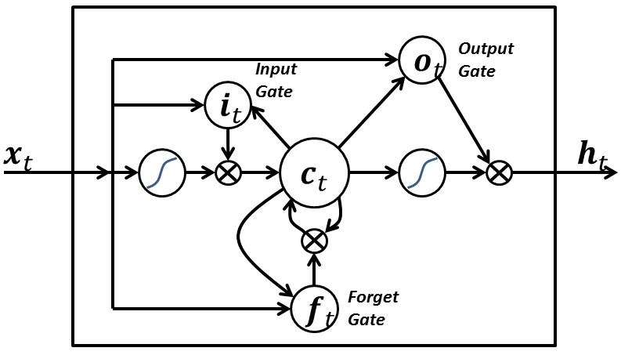
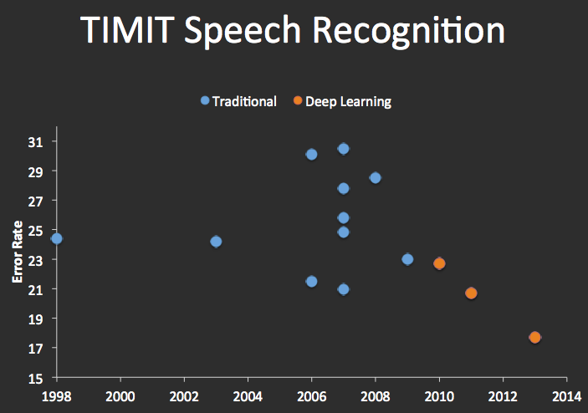
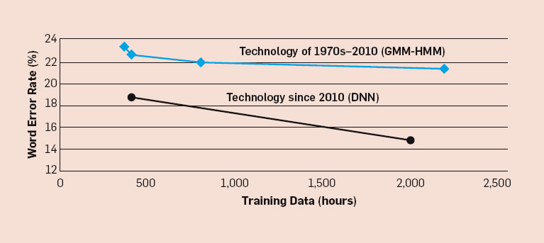
Milestones3: Speech Recognition
Recurrent Nets: LSTMs (1997):

Slide 14
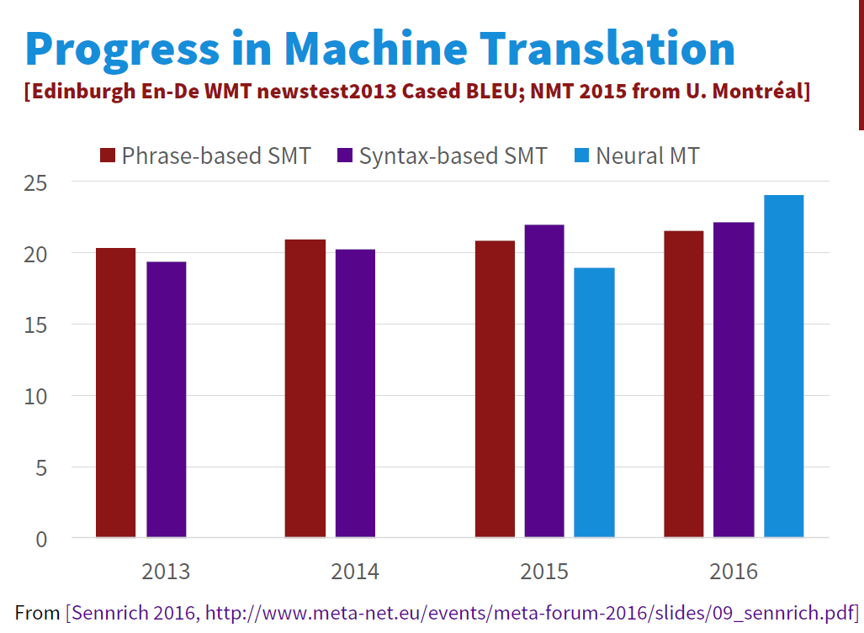
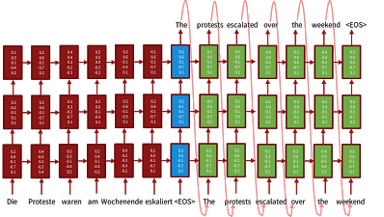
Milestones4: Language Translation
Sequence-to-sequence models with LSTMs and attention:
Source Luong, Cho, Manning ACL Tutorial 2016.

Slide 15
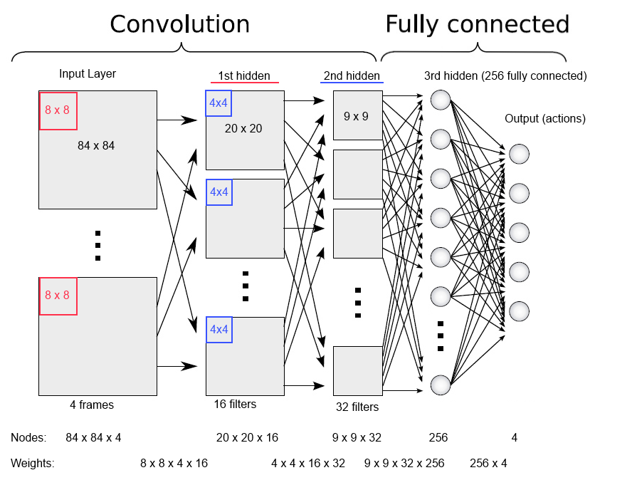
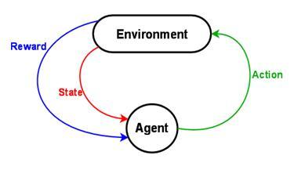
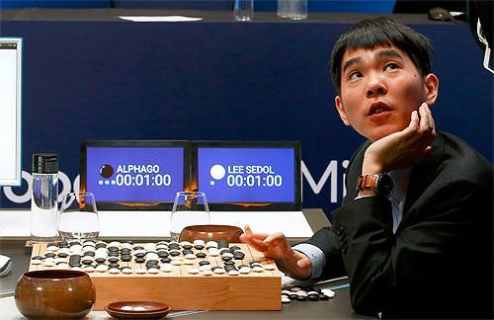
Milestones5: Deep Reinforcement Learning
In 2013, Deep Mind’s arcade player bests human expert on six Atari Games. Acquired by Google in 2014,.
In 2016, Deep Mind’s
alphaGo defeats former world champion Lee Sedol
Notes:
Founders: Demis Hassabis, Shane Legg, Mustafa Suleyman
Why was this milestone particularly worrying from an ethics point of view?
从错误中学习, 最后找到规律

Slide 16
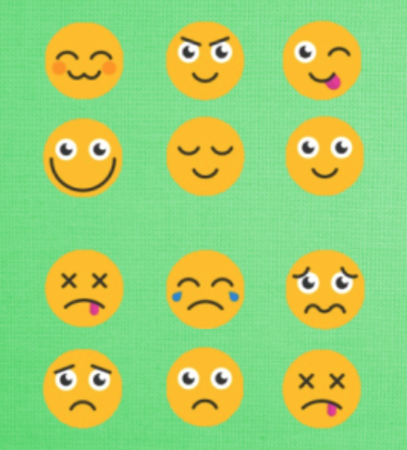

Slide 17
Deep Learning: Is it Hype or Hope?

Slide 18
Deep Learning: Is it Hype or Hope?
Yes !

Slide 19
Learning about Deep Neural Networks
Yann Lecun quote: DNNs require: “an interplay between intuitive insights, theoretical modeling, practical implementations, empirical studies, and scientific analyses”
i.e. there isn’t a framework or core set of principles to explain everything (c.f. graphical models for machine learning).
We try to cover the ground in Lecun’s quote.

Slide 20
This Course (please interrupt with questions)
Goals:
Introduce deep learning to a broad audience.
Review principles and techniques (incl. visualization) for understanding deep networks.
Develop skill at designing networks for applications.
Materials:
Book(s)
Notes
Lectures
Visualizations

Slide 21
Course content
Course Overview
Introduction to Deep Learning
Optimization
Backpropagation
Convolutional Networks（CNN）
Recurrent Networks（RNN)

Slide 22
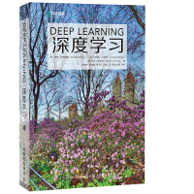

Reference
Ian Goodfellow,《Deep Learning》,人民邮电出版社，2017
[美] 弗朗索瓦·肖莱（Francois Chollet），《PYTHON深度学习》，人民邮电出版社，2018
李沐，动手学深度学习课程 (d2l.ai)

Slide 23
Deep learning framework:
Caffe
Tensorflow(Google)
Pytorch(Facebook)
Mmdetection（商汤，香港中文）
PaddlePaddle(百度)
MindSpore（华为）
https://www.mindspore.cn/

Slide 24
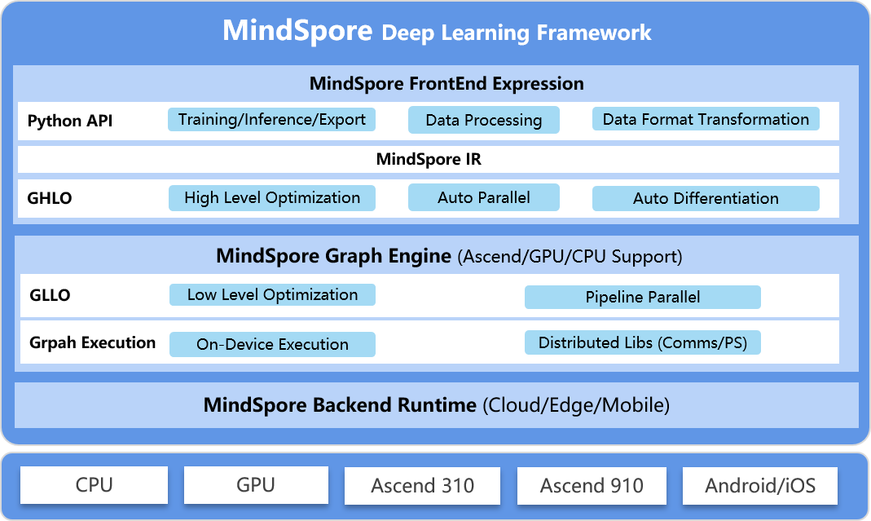
Mindspore

Slide 25
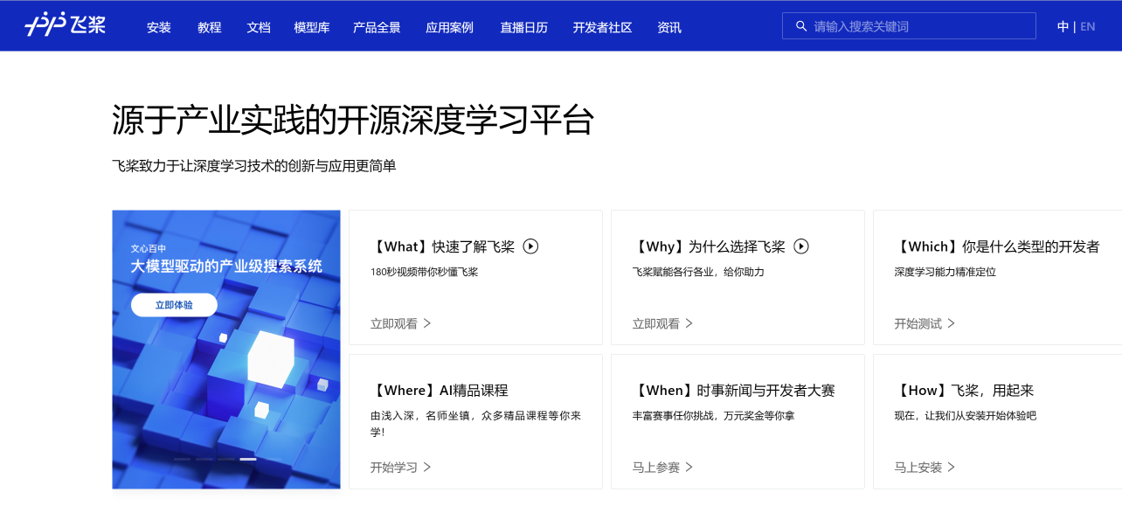
百度飞桨PaddlePaddle
百度公司研发的深度学习框架
国内应用规模第一的深度学习框架
包括详细的中文文档和应用工具
截止2022年底，飞桨平台
聚集535万开发者
服务20万家企事业单位
构建了67万个模型
算法总数超过600个

Slide 26

百度飞桨 AI Studio
深度学习在线教育平台
课程
项目
比赛
数据集
……
http://aistudio.baidu.com
百度AI Studio上的典型课程

Slide 27
Course Assessment
Research study:30%(teamwork)
Study on selected topics
Submit: research report(6-8 pages) and code
Oral presentation:20%(teamwork)
10 minutes each talk in the last 1-2 weeks
Submit: PPT
Experiments:30%
2 experiments
Submit: experimental reports
Reading report:20%
Submit:report

Slide 28
Research report
Title, Author(s)
Abstract: Briefly describe your problem, approach, and key results. Should be no more than 300 words.
Introduction (10%): Describe the problem you are working on, why it's important, and an overview of your results
Related Work (10%): Discuss published work that relates to your project. How is your approach similar or different from others?
Data (10%): Describe the data you are working with for your project. What type of data is it? Where did it come from? How much data are you working with? Did you have to do any preprocessing, filtering, or other special treatment to use this data in your project?
Methods (30%): Discuss your approach for solving the problems that you set up in the introduction. Why is your approach the right thing to do? Did you consider alternative approaches? You should demonstrate that you have applied ideas and skills built up during the quarter to tackling your problem of choice. It may be helpful to include figures, diagrams, or tables to describe your method or compare it with other methods.
Experiments (30%): Discuss the experiments that you performed to demonstrate that your approach solves the problem. The exact experiments will vary depending on the project, but you might compare with previously published methods, perform an ablation study to determine the impact of various components of your system, experiment with different hyperparameters or architectural choices, use visualization techniques to gain insight into how your model works, discuss common failure modes of your model, etc. You should include graphs, tables, or other figures to illustrate your experimental results.
Conclusion (5%) Summarize your key results - what have you learned? Suggest ideas for future extensions or new applications of your ideas.
Writing / Formatting (5%) Is your paper clearly written and nicely formatted

Slide 29
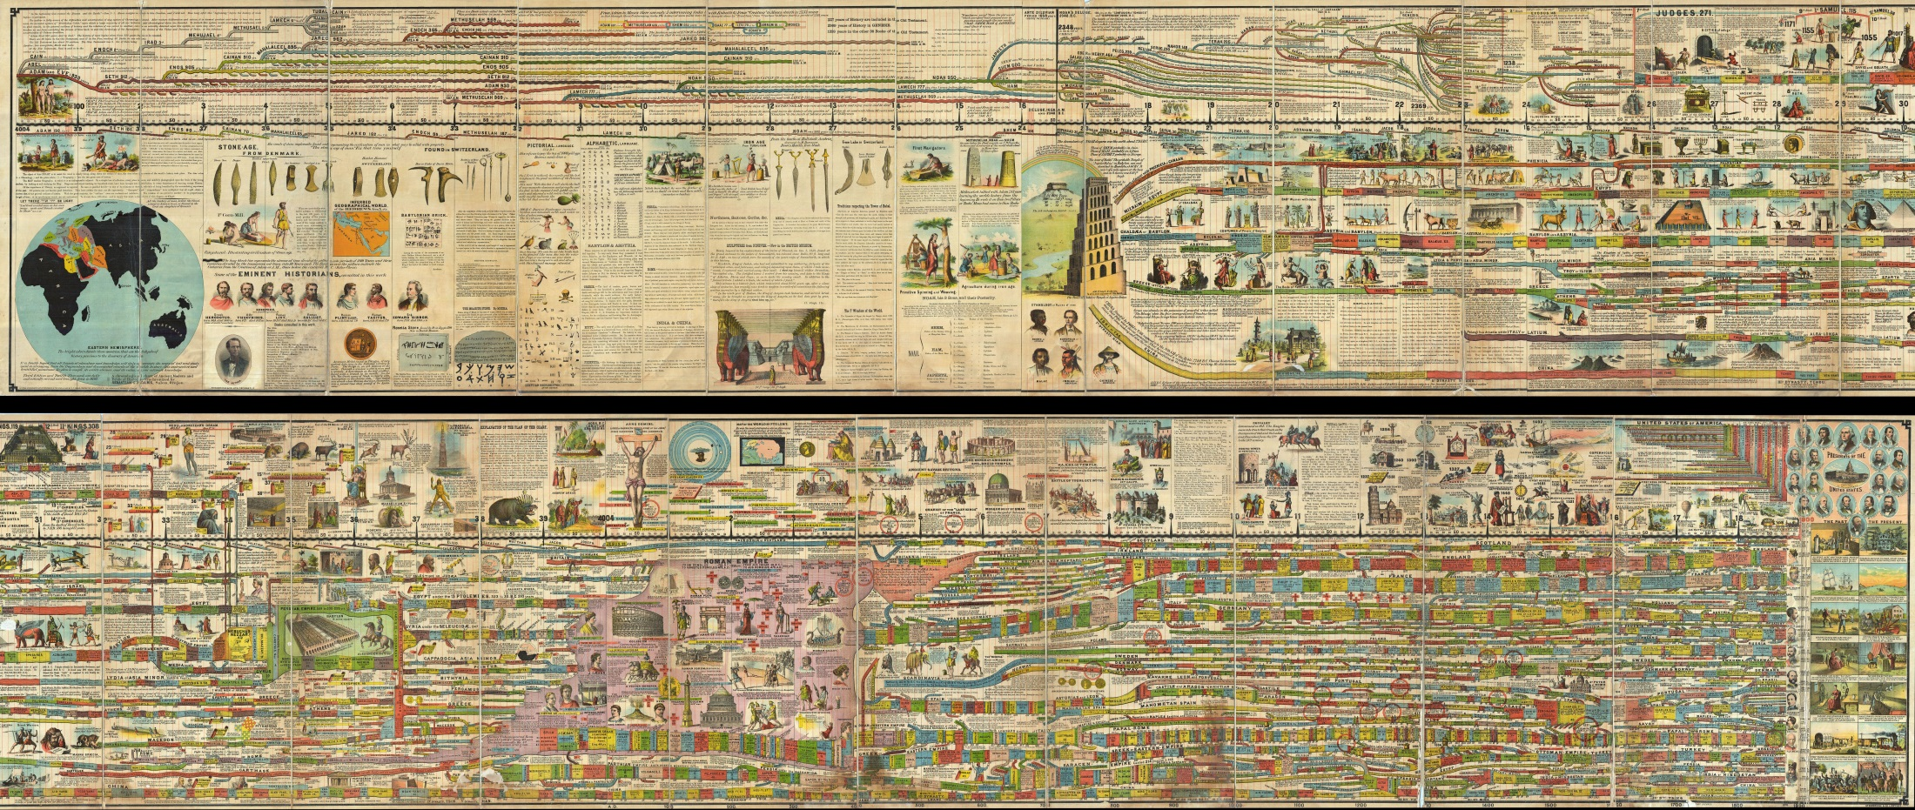
Some History
Reading: the Deep Learning Book, Introduction

Slide 30
Phases of Neural Network Research
1940s-1960s: Cybernetics（控制论）: Brain like electronic systems, morphed into modern control theory and signal processing.
1960s-1980s: Digital computers, automata theory, computational complexity theory: simple shallow circuits are very limited…
1980s-1990s: Connectionism: complex, non-linear networks, back-propagation.
1990s-2010s: Computational learning theory, graphical models: Learning is computationally hard, simple shallow circuits are very limited…
2006→: Deep learning: End-to-end training, large datasets, explosion in applications.

Slide 31
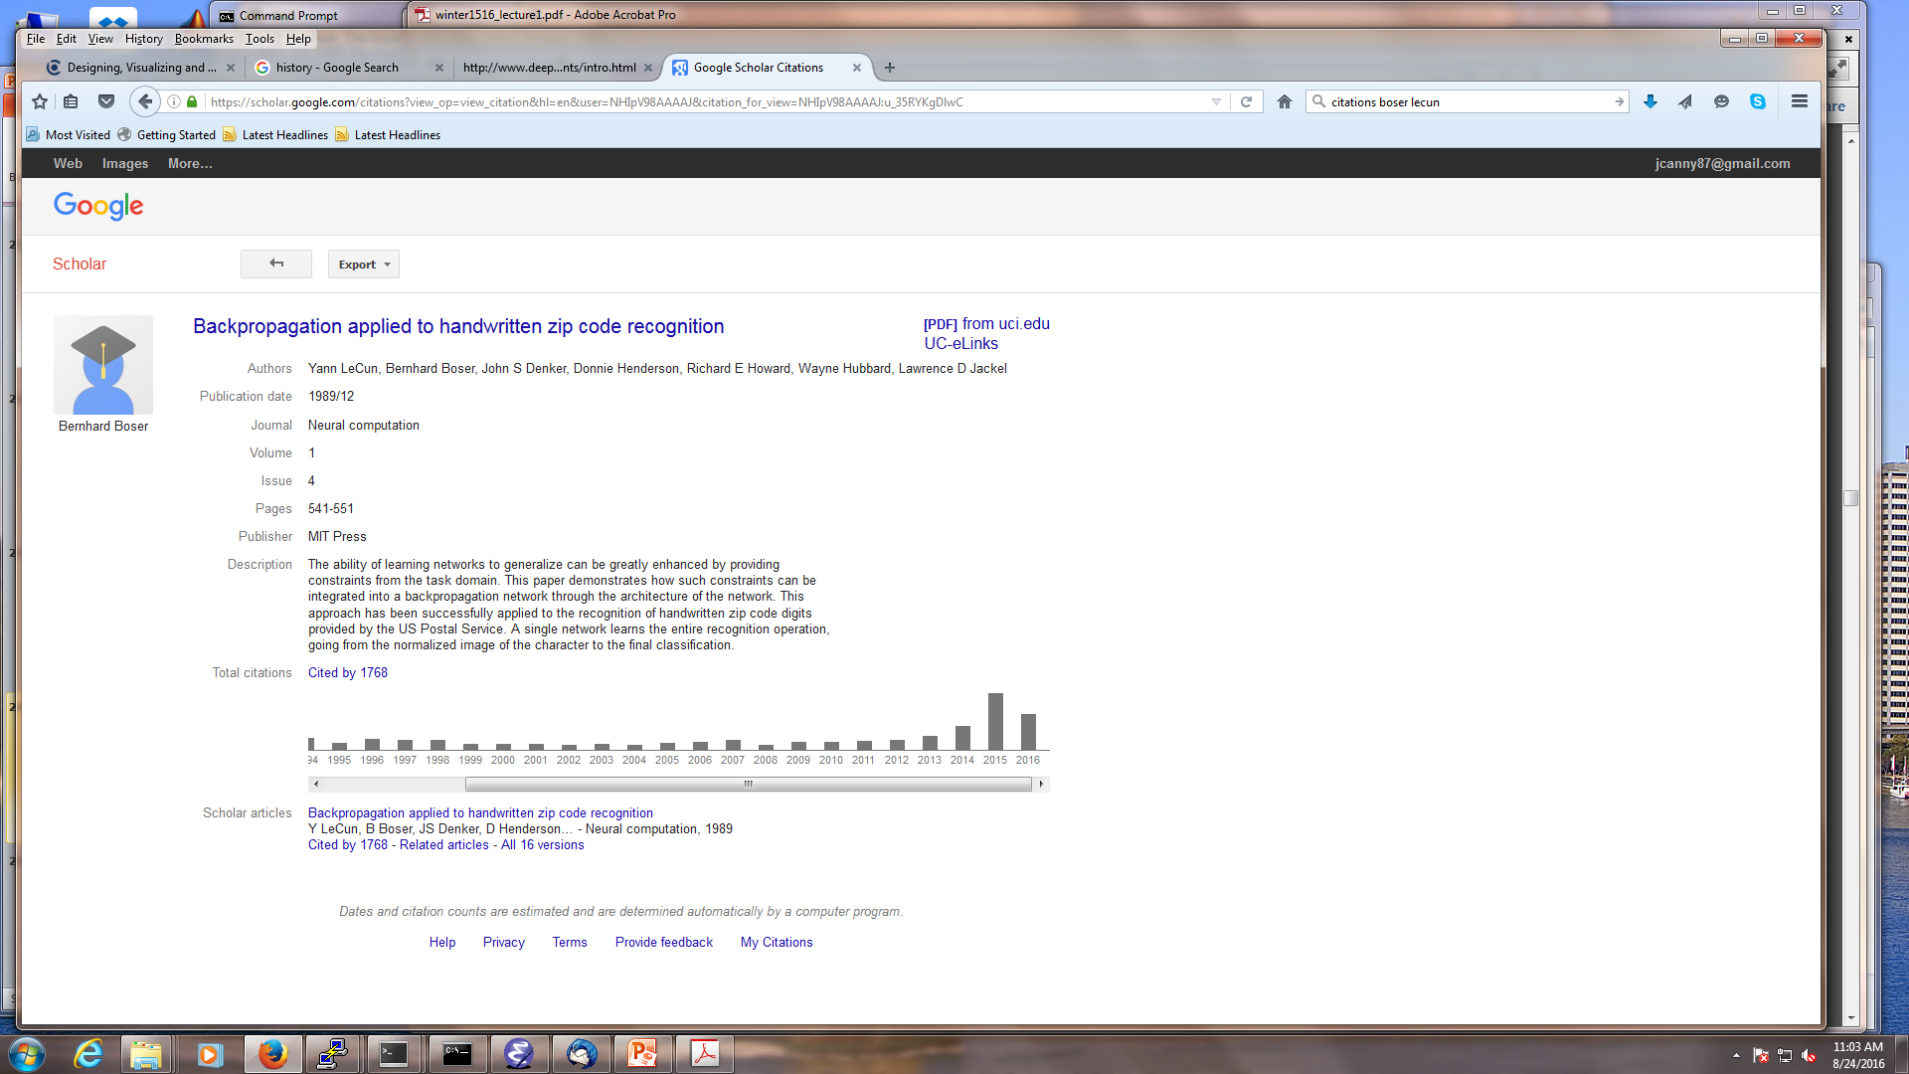

Citations of the “LeNet” paper
Recall the LeNet was a modern visual classification network that recognized digits for zip codes. Its citations look like this:
The 2000s were a golden age for machine learning, and marked the ascent of graphical models. But not so for neural networks.
Second phase
Deep Learning “Winter”
Third phase

Slide 32
